Slide 1
[
]
MAWEBCENTERS & B2B SOLUTIONS
2018 Market Singapore Leadership School
Notes:
SR

Slide 2
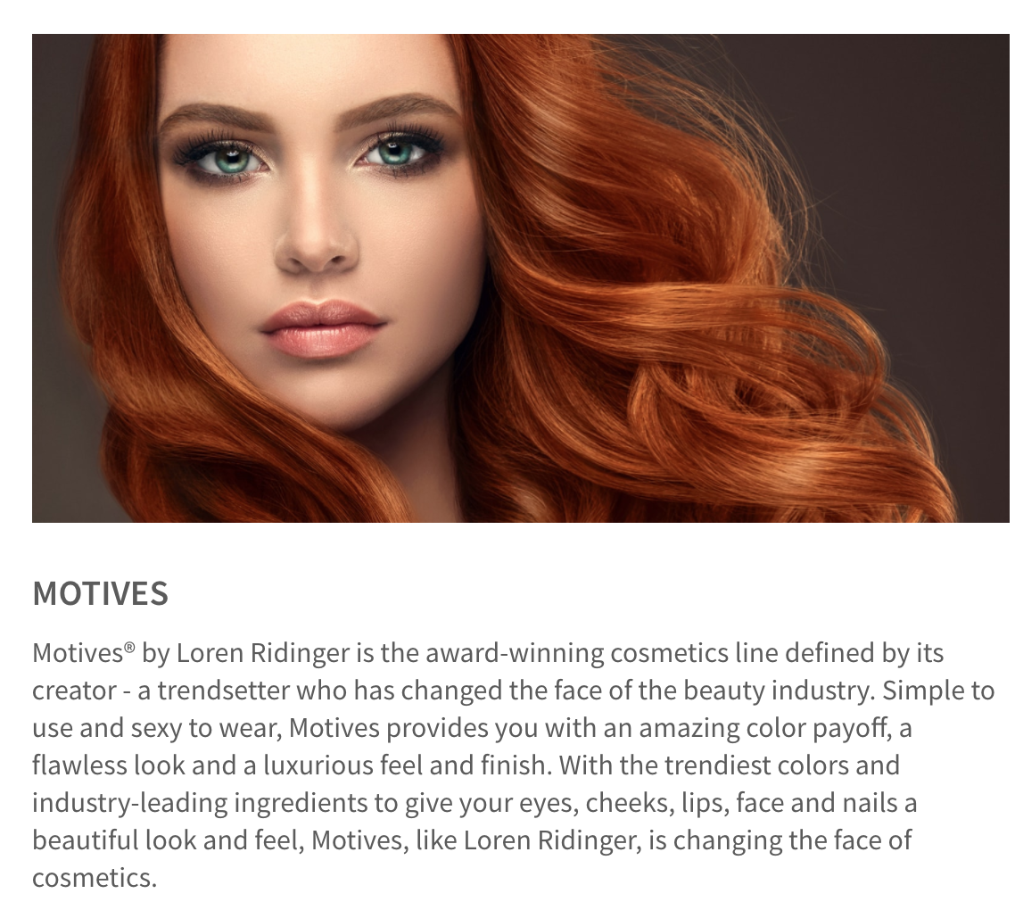
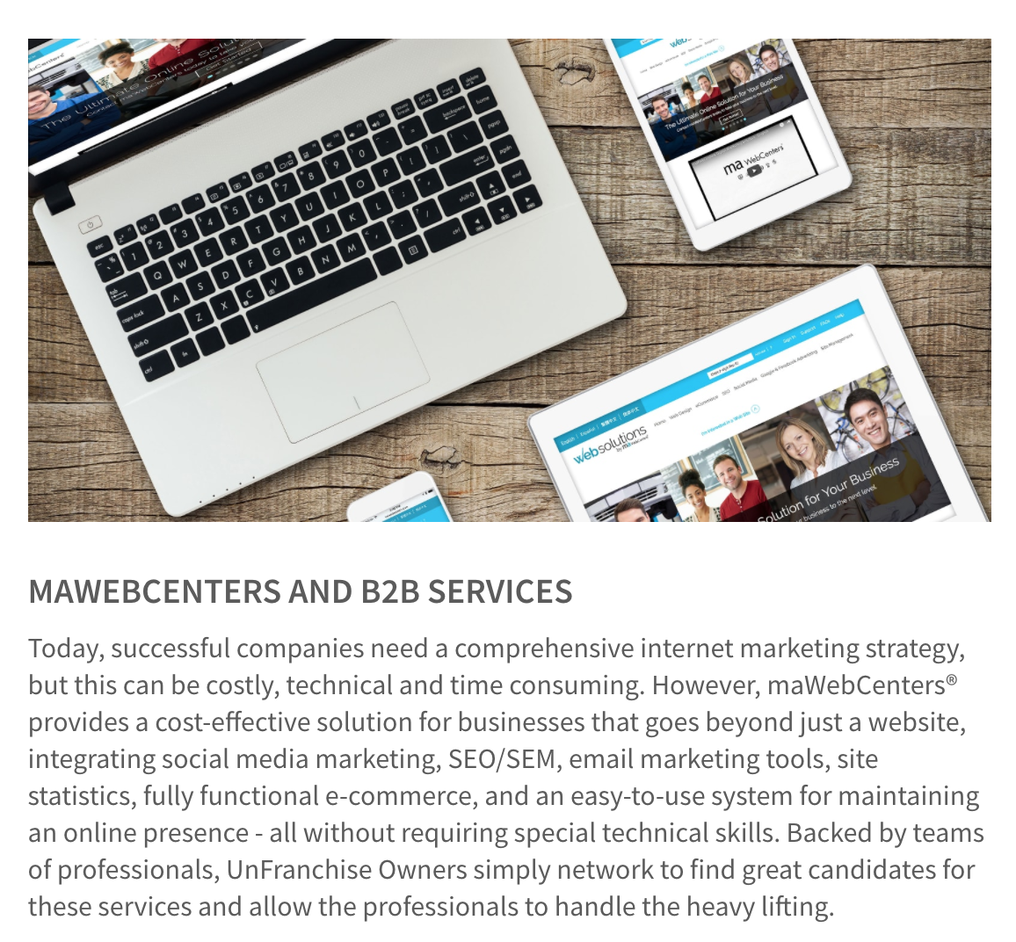
UNIVERSITY MAJORS & AREAS OF SPECIALISATION
Exclusive Brands & Services
Proven sales system, support tools & education
Give & Get referrals within your team
PICK ONE OR TWO – LEARN TO EDIFY YOUR TEAM!
Almost every division touches the B2B sector in some way, at some points

Slide 3
A PROVEN, DUPLICABLE, SYSTEM TO PROVIDE
SMALL BUSINESS OWNERS AN EFFECTIVE INTERNET PRESENCE TOGETHER, WE HELP BUSINESSES AND ORGANISATIONS WITH:
Increasing Customer Satisfaction
STREAMLINING BUSINESS PRACTICES
Decreasing Expenses
INCREASING ENGAGEMENT
Increasing Revenues
MARKETING THEIR BUSINESS

Slide 4
Proven system for success
YOU TALK TO BUSINESS OWNERS AND SET AN APPOINTMENT.
SALES TEAM
DESIGN, DIGITAL, SUPPORT TEAMS
CLIENT GETS A GREAT SITE AND SUPPORT MARKETING IT
Notes:
TRAINER’S NOTES:
1 minute
Shows the simple sales system.

Slide 5
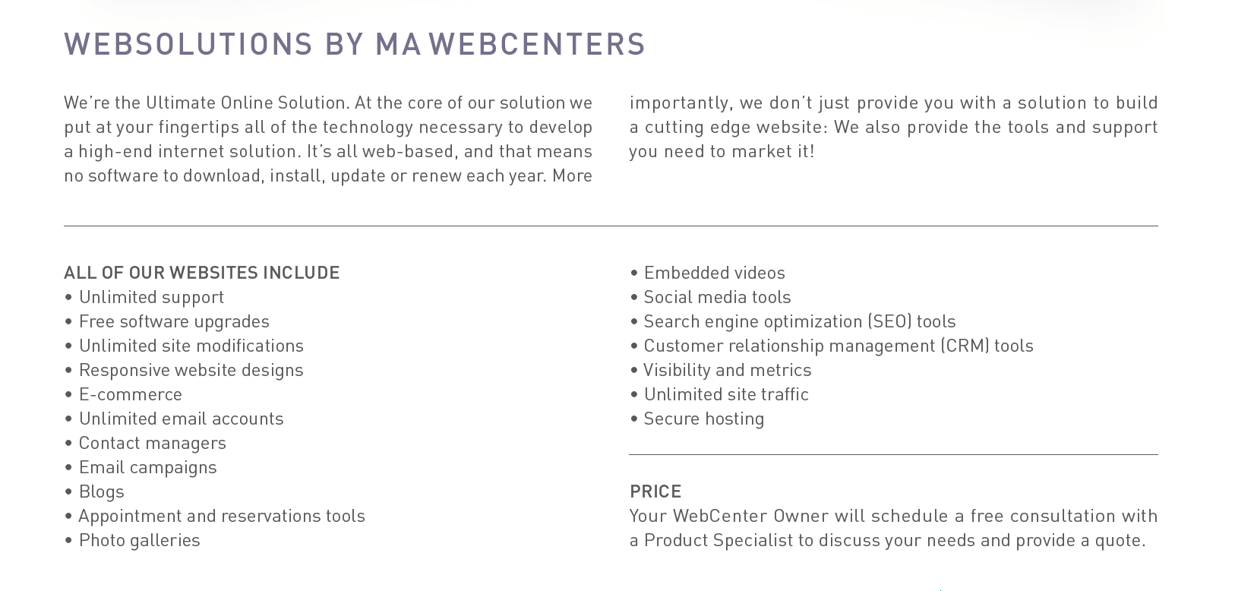
MORE THAN JUST A WEBSITE
DIGITAL MARKETING PRODUCTS
Design, SEO, Google Ads, Social Media Management, Facebook Ads, Online Reputation management, Content Writing
Notes:
Trainers Notes:
This is just an intro slide – The goal here is to get them excited about what we are going to talk about.
In brief, cover the big topics “Websites, Marketing Tools, Unlimited, Support, Security)
The goal is to paint a simple picture of how all –inclusive our solution actually is / Instill confidence in the product.
Spend 1 minute or less on this slide – the details are coming up!

Slide 6
WEBSITE DESIGN
Your website design not only reflects your business but also determines how engaged your visitors are
OPTION 1: TECH SUPPORT Website Clients have unlimited access to Tech Support
OPTION 2: DESIGN CENTER
Purchase Design. Our designers can design a professional website with strong branding within the WebSolutions platform.
www.mawebcenters.com
Notes:
TRAINER’S NOTES:
Clients have two choices for designing their site
Choice one is to do it themselves. Tech support will help them with technical questions, but the business owner is the one doing the work
The other option is to purchase a design package where our team does it for you
DC Adds Value!
Better Experience for your Client!

Slide 7
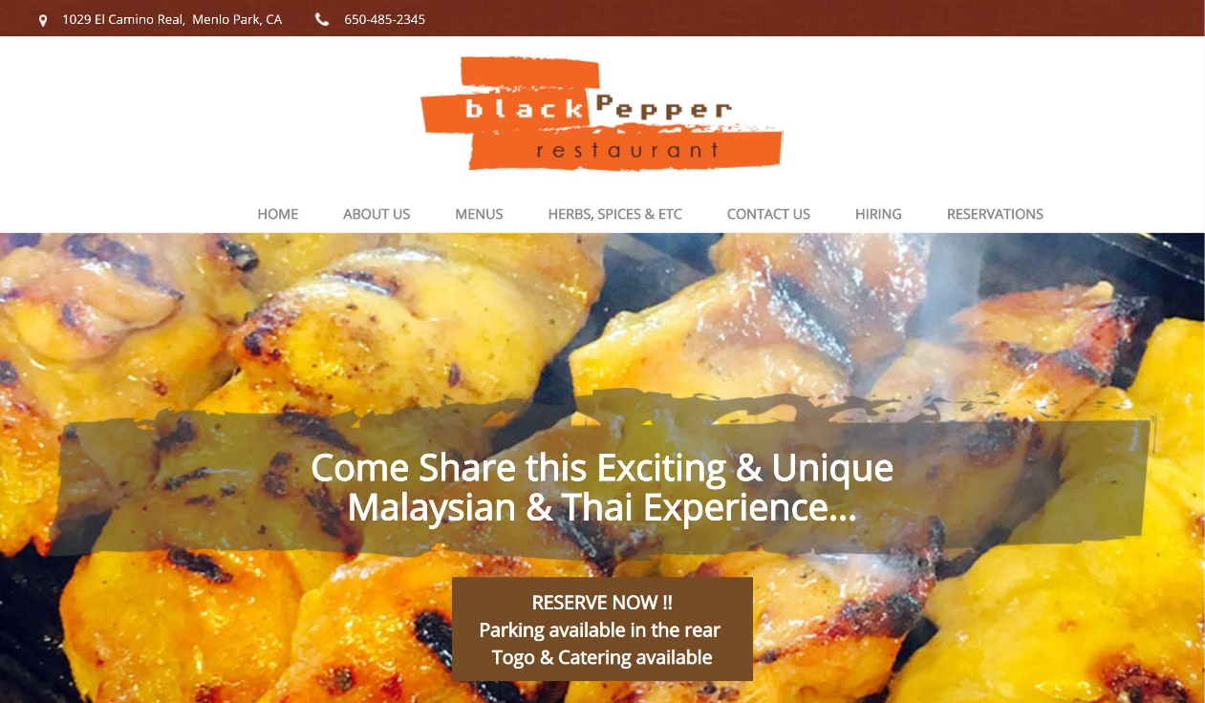
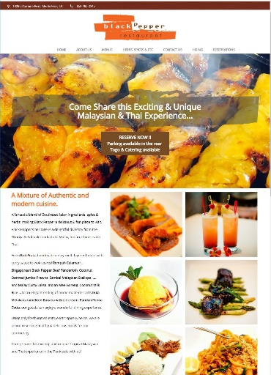
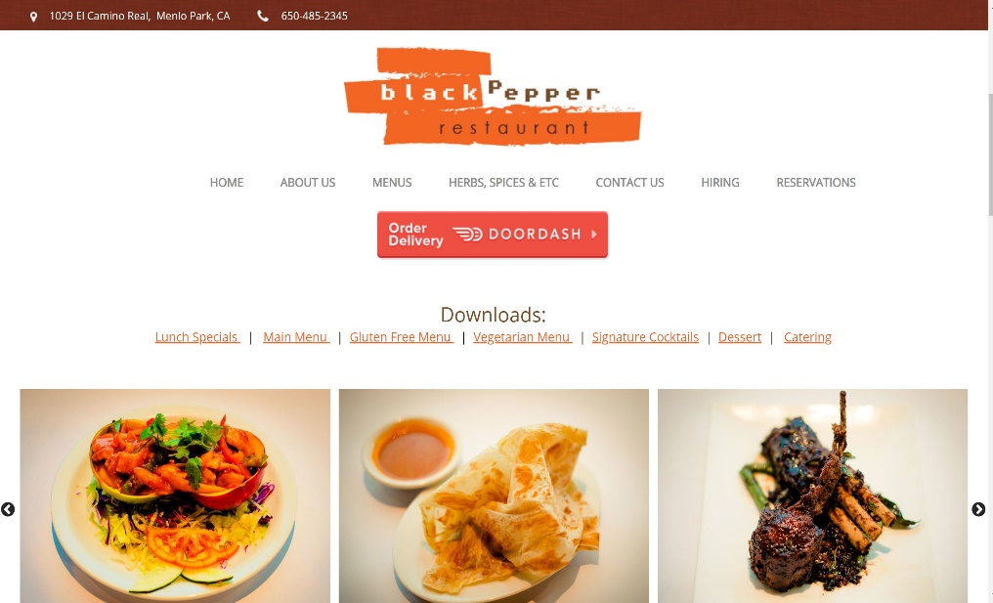
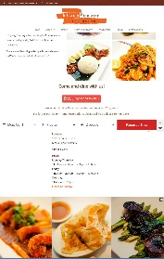
DESIGN CENTER

Slide 8
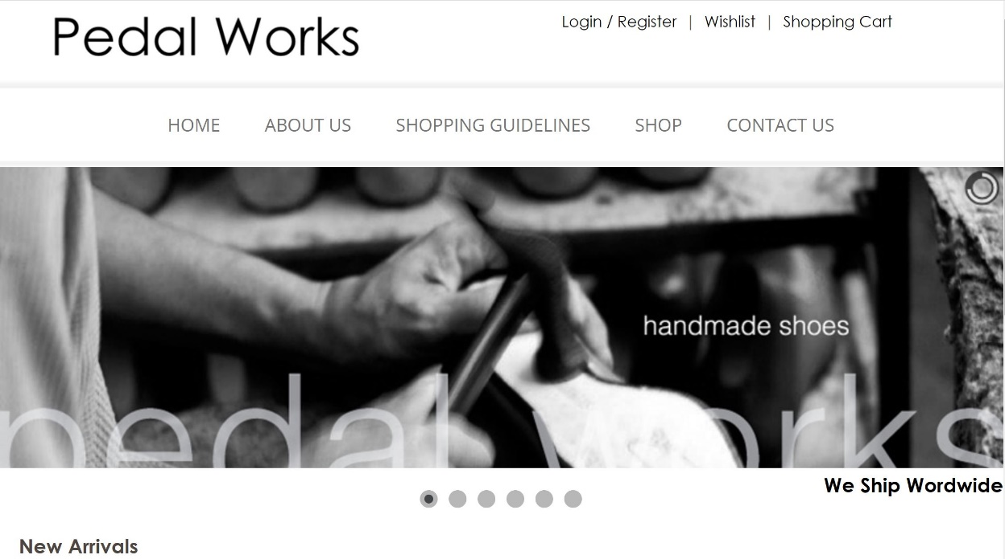
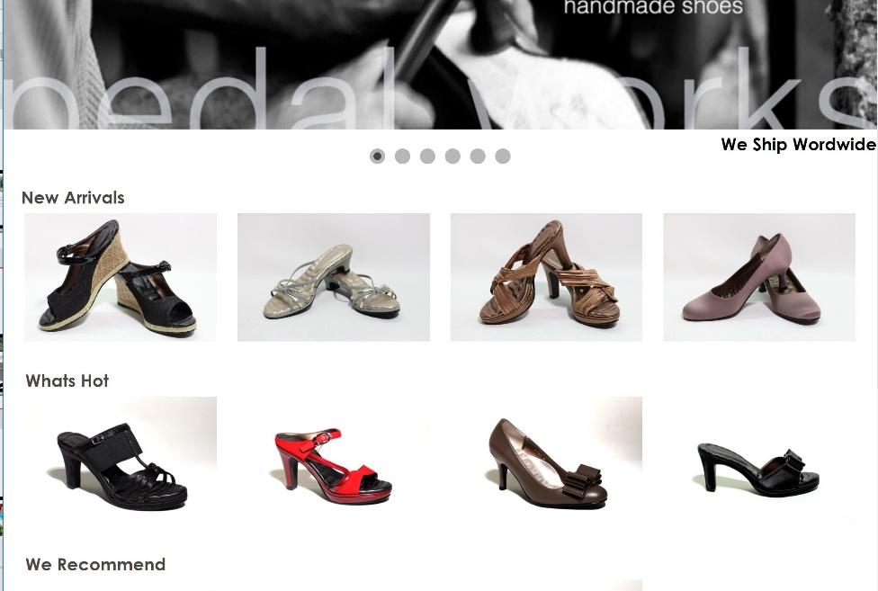
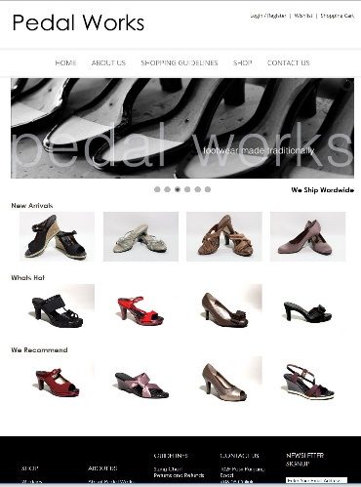
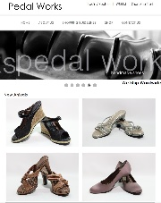
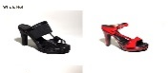
DESIGN CENTER

Slide 9
DESIGN CENTER

Slide 10
AWARD WINNING UNLIMITED CUSTOMER CARE
Unlimited help editing the site
Support using all features & tools in our solution
Home country, 24/7 support
Ultra-secure hosting facility 24x7 Security and incident monitoring, hosted on tiered, high performance Dell PowerEdge servers, protected from fire, floods, earthquakes, power outages, and other types of disasters
Dual-layer firewall protection Using Cisco PIX firewalls
Notes:
Trainers Notes:
Share Stories!

Slide 11
The Power of Unlimited
Unlimited Pages
Unlimited Changes
Unlimited Traffic
Unlimited E-mail Address
Unlimited Upgrades
Unlimited support, changes and upgrades.
We take away the challenges that business owners face to stay current with their online marketing solution.
Notes:
Trainers Notes:
Self Explanatory

Slide 12
Build share of customer
Your client buys a website
AND wants to market the site
YOU CAN START WITH A WEBSITE SALE OR A DIGITAL MARKETING PRODUCT SALE
GROW THE RELATIONSHIP TO BUILD SHARE OF CUSTOMER
Notes:
TRAINER’S NOTES:
Take a look at what the Digital Marketing Products generate
Remember, full pricing and BV is available on mawc411.com/support.html

Slide 13
SOCIAL MEDIA
SOCIAL MEDIA
Social Media Management, Online Reputation Management, Facebook Advertising
DIGITAL MARKETING
Local SEO, Regional SEO, Google Advertising, Content Writing, Wordpress.org
WEBSITE HOSTING & MANAGEMENT
Basic Monthly Membership Monthly Maintenance & Management Managed Monthly Membership
WWW.MAWC411.COM
Notes:
TRAINER’S NOTES:
Showcases all of the services that a client can purchase through maWebCenters
The big difference is whether someone will do it themselves, or leverage our teams of experts to do it for them

Slide 14
UFO PROFITABILITY
When considering any business venture, you want to evaluate how it can impact your income long & short term.
SHORT TERM GOALS
Your short-term financial goals can typically be handled by increasing cash flow (RETAIL PROFITS)
LONG TERM GOALS
Your long-term financial goals can typically be handled by increasing ongoing income (MPCP)

Slide 15
AVERAGE RETAIL PROFITS :
USA, MX, CAN, AU, SGP: US$1,000
UK: £700
HK: HK$7,700
TW: NT$32,000
Divide your short term goal by your average
retail profit to determine how many sales it will take to reach your goal.
For example: A WCO has $5,000.00 in debt divided by $1,000.00 = 5.
Therefore, just 5 new sales could pay for the initial goal of $5,000.
Short term goals can be met with retail profits
Notes:
TRAINER’S NOTES:
Again – you can apply this to any of your fixed cost goals

Slide 16
Business Building
In our business, you don’t want your “major” to distract from overall business building.
GROUP BUSINESS VOLUME
BV & IBV from customer sales is “Autoship” in nature. How does that add up?
(Group Business Volume)
SHOPPING ANNUITY
Do WebCenter Owners spend money?
How does your client’s spending compare to an average family spending?

Slide 17
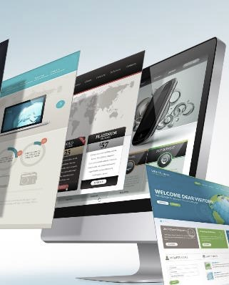
Each website sold
generates 230 BV
Each active client
generates
5, 30 or 35 BV / MoNTH
DIGITAL MARKETING PRODUCTS GENERATE ADDITIONAL BV AND RETAIL PROFITS
Notes:
TRAINER’S NOTES:
Long Term Potential for WCOS = Ongoing BV and Retail Profits

Slide 18
Australia
Bahamas
Bermuda
Canada
Chile
China
Columbia
Costa Rica
Dominican Republic
Ecuador
Hong Kong
Indonesia
Ireland
Jamaica
Macau SAR China
Mexico
New Zealand
Panama
Philippines
Singapore
Spain
Taiwan
United Kingdom
United States
YOUR GLOBAL WEBCENTER
Your WebCenter is automatically enabled to sell websites globally in all Market Countries & EMP Countries. You earn Home Country Retail Profit & BV!
Notes:
TRAINER’S NOTES:
What does that do for us?
First, by having websites which are completely in other languages and the entire back end of the system, including the menus and contextual help, the business owners who are more comfortable with another language will be able to take more effective use of the solution.
Second, by providing all the support, from sales to ongoing support with clients, all in multi-languages.
As a non-native speaker, you can probably find numerous business owners who you can have a short conversation to set an appointment with, but you wouldn’t be able to do a sales walkthrough because the business owner might not understand English well enough. This way, all you need to do is set the appointment, and let the team handle the rest for you!
And we all know that some of your best business prospects are business owners and customers of yours. This is a very natural way to lead to prospects for the business in a cultural market you might not have thought you could make inroads to.

Slide 19
TRAINING & SUPPORT
MAWC411.COM
WCT 101 & 201
Overview Webinars
www.mawc411.com

Slide 20
WCT 101
WCT 101: Succeeding with WebCenters
WCT101 is designed to give you a simple and duplicable system for building your UnFranchise Business as a WebCenter Owner. The Product: How does our product compare and benefit your customer
The Opportunity: WebCenter goal setting and strategic planning
Simple Sales Approach: How to sell appointments
Using Your WebCenter: WebCenter fundamentals Learning Business Building: Duplicating WebCenters in your organisation

Slide 21
WCT 201
WCT 201: Advanced Selling & Networking The Market Place: Overcoming consumer confusion Building value with clients
Goal Assessment: Redefining goals, Organisational systems
Retailing: Lead generation, networking, confirming appointments advanced selling
Business Building: Building Share of Customer, Mentoring an Intern, Conducting a 12 Week Action Plan

Slide 22
B2B Networking Event
Business Networking Event UnFranchise Owners can now leverage on this event to educate potential Website and Digital Marketing Clients on the power of services provided by maWebCenters.
Class features a 30 minute networking session, followed by a presentation about Web Design and Digital MarketingPlan
Duration: 90 minutes (30 mins for assessment and networking)
Who should attend: UFO and their prospects who are interested in digital marketing and digital marketing trend

Slide 23
WEBCENTER MONTHLY WEBINAR
Get the chance to learn up close from international trainers, speakers as well as local trainers!
Each month, various trainers and speakers will be invited into the webinar to share their knowledge with local WebCenter Owners.
JOIN US NOW!
Time: 8pm
Speaker: International Speakers,
WebCenter Trainers, Local Trainers
Notes:
Trainers Notes:
Share Stories!

Slide 24
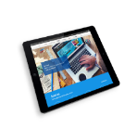
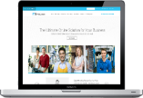
YOUR OPTIONS
Proven system for success
WEBCENTER INTERN
LEARN THE PROCESS
LEVERAGE THE PROFESSIONALS
EARN RETAIL PROFIT TO LAUNCH YOUR WEBCENTER
WEBCENTER FAST START
LAUNCH YOUR UNFRANCHISE
SELECT THE WEBCENTER FAST START KIT
PURCHASE WEBCENTER CODE : SG6040 $455.00 SGD 300BV
REACTIVATE WEBCENTER CODE : SG6040RA $195.00 SGD NO BV
Notes:
TRAINER’S NOTES:
Briefly cover the options to get started as a WebCenter Owner

